Slide 1


What S&P 500 returns forecast can tell us about the underlying market patterns?
Comprehensive analysis of Forecasting models

Slide 2
Introduction
Objective and Goals
The objective is to develop predictive models that can provide insights into future price movements, aiding investors, analysts, and policymakers in making informed decisions.
- Unveil diverse forecasted model patterns for S&P 500 returns.
- Analyze multifaceted factors shaping index performance, including the 10-Year Treasury Note Yield, CPI, and Unemployment Rate.
- Illuminate potential future market directions, assisting investors in navigating the complex financial terrain
- The S&P 500, tracking 500 major U.S. companies, is a key stock market index.
- Current market trends reveal steady growth, notably in the technology sector, fueled by low-interest rates, strong corporate earnings, and a positive economic outlook.
- Underlying market patterns include the increasing dominance of technology companies, a trend toward sustainable investing focusing on ESG practices, and a rising interest in alternative investments like cryptocurrencies and real estate.
Notes:
Choosing metrics

Slide 3
Methodology
Data : S&P 500 (from 2010-present), 10 year U.S Treasury Notes(TNX), Consumer Price Index(CPI), Unemployment Rate
The data is split into training and validation, with training from 2010-2023 and validation from 2023-present
To identify trends and patterns and for accurate returns prediction for the S&P 500 I used Holt-Winters exponential smoothing, ARIMA or SARIMA and Multiple Linear Regression
To evaluate the predictive accuracy, I utilized standard metrics such as RMSE and MAPE
Notes:
Choosing metrics

Slide 4
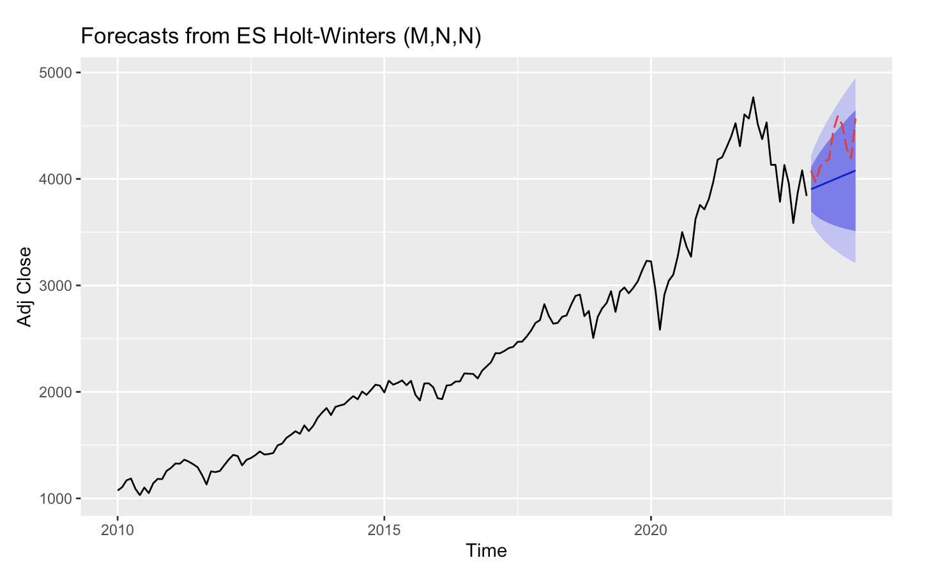
Holt-Winters Exponential Smoothing
This method is effective when dealing with time series data exhibiting trend and seasonality by incorporating smoothing factors for the components. It is adaptive and can adjust to changes in underlying patterns over time
Using R’s optimizing features, we identified the best-fitting model with parameters M, N, N
Training set: RMSE - 119.17, MAPE - 3.20, Test Set: RMSE - 335.52, MAPE - 6.62
Point forecast for December 2023: 3903.29
The values show that while the model is effective in capturing the training data's patterns, it may be less adept at generalizing to unseen data. However, the point forecast is in the expected range
Notes:
Used different parameters, but overfitting/underfitting as a team decided to go with automatic R
s - many features
t - choose optimal
a - Used different parameters, but overfitting/underfitting as a team decided to go with automatic R optimization
r - accurate forecast

Slide 5
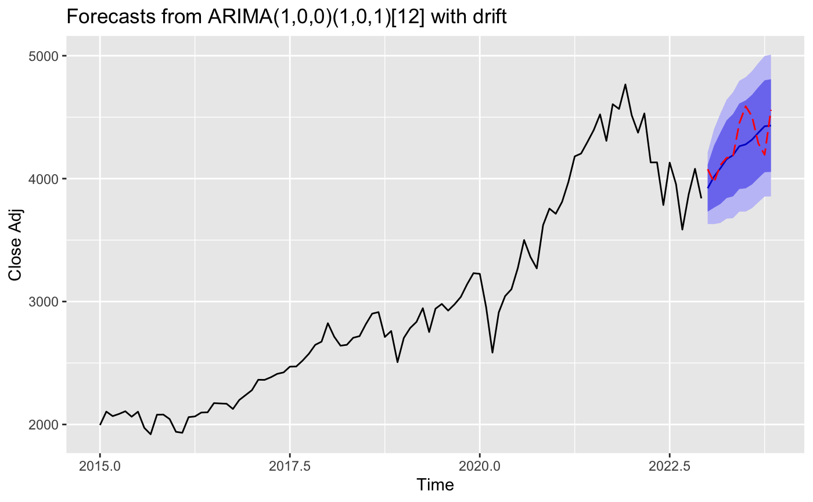
ARIMA (Seasonal ARIMA)
SARIMA models incorporate autoregressive and moving average components and involve differencing to remove trends and seasonality.
The ACF/PACF analyses indicated a SAR(1) model with significant spikes at lags of 12, 24, and 36 months, suggesting a strong yearly pattern.
ARIMA(1,0,0) model : RMSE - 194.36 MAPE - 3.55
SARIMA(1,0,0)(1,0,1)12 model : RMSE - 176.74 MAPE - 3.29
Including a moving average component improved training performance but decreased test set robustness and adding a seasonal component gave the best fit and aligned training and test set performances.
Notes:
No Optimal model, we need to do lot of analysis to come up with the good fit model. based on gathered information, we come up with different bottle neck issues with different models.
result- brainstormed the KPI’s to eliminate the improper models and come up with the best model.
limitations - overfitting/underfitting,

Slide 6
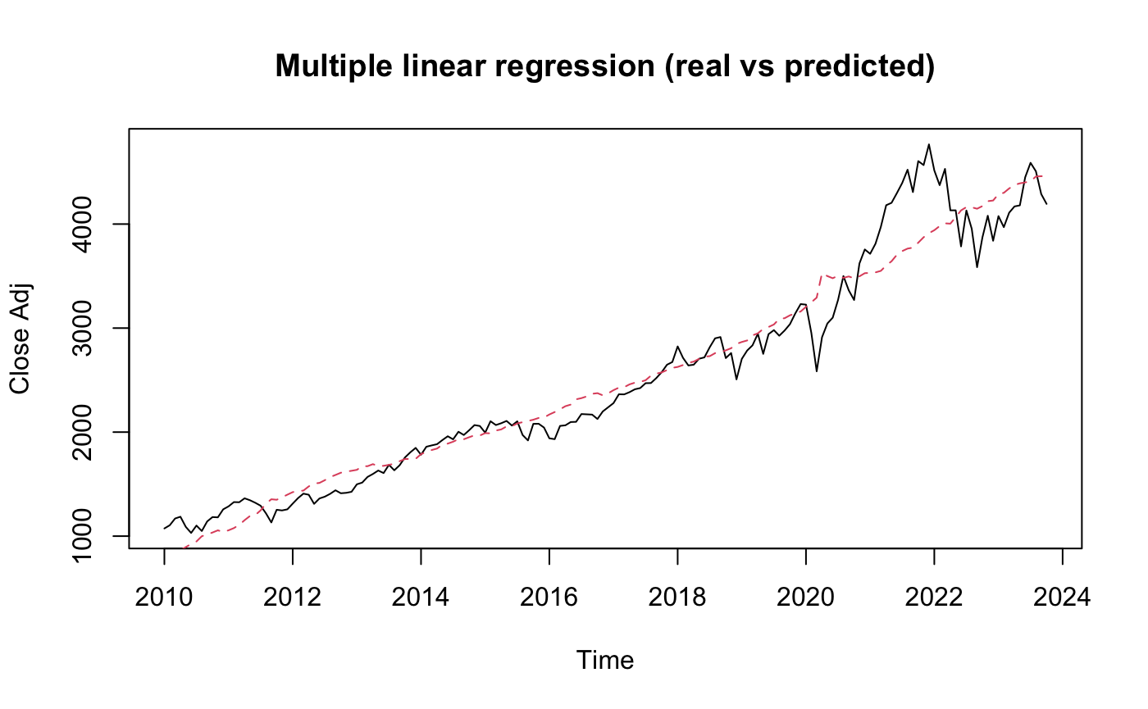
Multiple Linear Regression
MLR helps identify statistically significant relationships between dependent (S&P500) and independent (10-Year Treasury Note Yield, CPI, and Unemployment Rate) variables
Correlation analysis showed a weak correlation between ten-year bond yields and the S&P 500, the unemployment rate showed a negative correlation, and CPI exhibited a strong positive correlation
RMSE - 246.79, MAPE – 7.41, Adjusted R-squared – 0.69

Slide 7
Future Steps
Addressing the limitations of generalizing unseen data for accurate long-term predictions in Holt-Winters Exponential Smoothing
Incorporating additional macroeconomic indicators that could impact the S&P 500, such as geopolitical events or policy changes, would potentially enhance the models' predictive power
For Multiple Linear Regression, exploration of the outliers to see if they represent rare events or trends and utilizing methods such as variable transformations to deal with heteroskedasticity

Slide 8
Challenges
Challenge | Strategy to Overcome
Handling changing priorities | Time management by sticking to self set deadlines
Choosing metrics for model evaluation | Trying multiple models and scenarios to pick the best describing metric
Addressing unexpected issues in model performance and interpretation | Developed a systematic approach to problem-solving, encouraged brainstorming sessions with TA, and sought input from the professor.

Slide 9
Conclusion
The analysis has provided valuable insights into the behavior and forecasting capabilities of three methods for the S&P 500 index.
The SARIMA model has the upper hand comparatively
Given the dynamic nature of external factors impacting the ever-changing index, the project's potential continues to expand.

Slide 10

Thank you
Indira Lakshmi Gundavarapu

